Slide 1
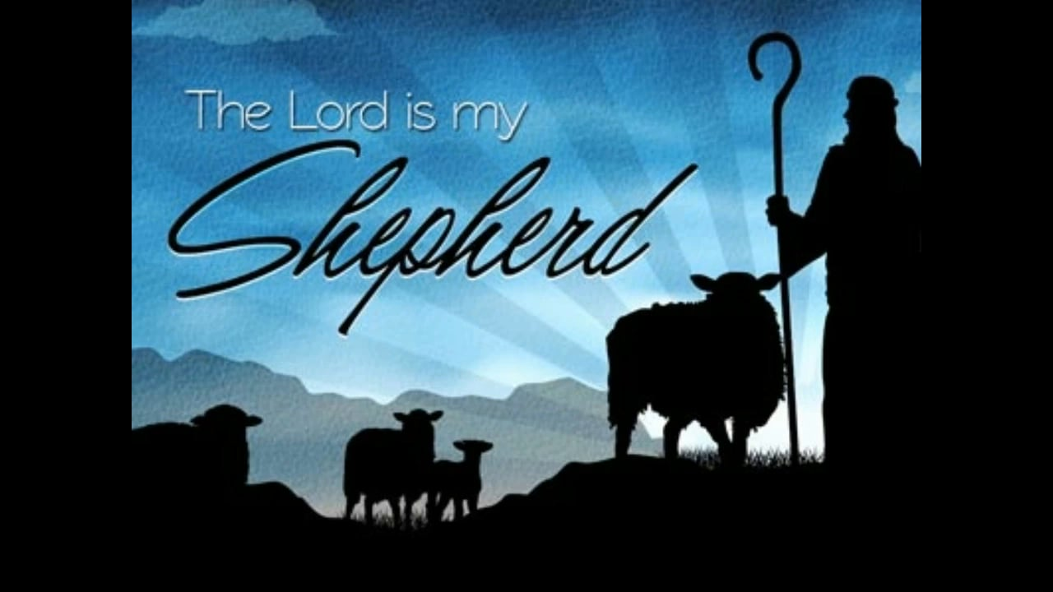
The 23rd Psalm
(Part 3)

Slide 2
Psalms 23
1 The LORD is my shepherd – FAITH
I shall not want – ASSURANCE
2 He maketh me to lie down in green pastures – CONTENTMENT
He leadeth me beside the still waters – PEACE

Slide 3
Psalms 23
3 He restoreth my soul – LIFE
He leadeth me in the paths of righteousness for his name's sake – LEADERSHIP
4 Yea, though I walk through the valley of the shadow of death – CONFIDENCE
I will fear no evil – COURAGE.
For thou art with me – COMPANIONSHIP
Thy rod and thy staff they comfort me – COMFORT

Slide 4
Confidence: “Yea, though I walk through the valley of the shadow of death”
The walk is the walk all men must take.
Hebrews 9:27; Ecclesiastes 9:5
Such confidence is born of hope. Philippians 1:23; 2 Corinthians 5:6,8
Such hope should rest upon the promises of God. 2 Peter 1:4; Hebrews 10:22-23
All the fear of death should be removed from us. Hebrews 2:14-15; Hebrews 13:5-6

Slide 5
Courage: “I will fear no evil”
David had shown courage all of his life.
cf.1 Samuel17:37
The man who fears God has no need to fear any other thing. Matthew 10:28; Acts 10:34,35; cf. Hebrews 13:5-6
John teaches us how to completely eliminate fear. 1 John 4:18

Slide 6
Companionship: “For thou art with me”
How can we have Him as our companion?
We must come to where God is. 1 Timothy 6:16
We must come to walk where He dwells.
1 John 1:5-7
We must keep His commandments.
1 John 2:3-5; 3:24; James4:8
cf. 2 Chronicles 15:2, “… Jehovah is with you, while ye are with him; and if ye seek him, he will be found of you; but if ye forsake him, he will forsake you.” cf. Deuteronomy 1:41

Slide 7
Companionship: “For thou art with me”
How can we have Him as our companion?
Must be careful not to go beyond God's word or encourage those who do.
2 John 9-10, “Whosoever goeth onward and abideth not in the teaching of Christ, hath not God: he that abideth in the teaching, the same hath both the Father and the Son. If any one cometh unto you, and bringeth not this teaching, receive him not into (your) house, and give him no greeting.”

Slide 8
Comfort: “Thy rod and thy staff they comfort me”
God would use His rod to punish His enemies. Psalms 9:16; Isaiah 10:5ff
His staff leads to a place of comfort for His followers. cf. 1 Corinthians 10:13; 1 Thessalonians 4:13-18; Revelation 14:13

Slide 9
Psalms 23
5 Thou preparest a table before me in the presence of mine enemies – PROVIDENCE
Thou anointest my head with oil – FAVOR
My cup runneth over – JOY
6 Surely goodness and mercy shall follow me all the days of my life – MERCY
And I will dwell in the house of the LORD for ever – IMMORTALITY

Slide 10
Providence: “Thou preparest a table before me in the presence of mine enemies”
We have the same promises.
  Proverbs 28:25, “… he that putteth his trust in Jehovah shall be made fat.”
  Psalms 37:25, “I have been young, and now am old; yet have I not seen the righteous forsaken, nor his seed begging bread.”
  cf. Matthew 6:32-33
The enemy may seem to have the victory, but the saints always win. Revelation 13:10; 14:12-13; 17:14; 19:11-21; 20:4-6.

Slide 11
Favor: “Thou anointest my head with oil”
To be anointed of the Lord is to:
  Be chosen of the Lord.
  The term “Christ,” means God's anointed.
  Be in His favor. cf. 1 Samuel 16:13
God has chosen and anointed certain ones today.
  “IN CHRIST” NOT INDIVIDUAL!
  Ephesians 1:3-4
  We are a chosen generation. 1 Peter 2:9
  And in His favor. 2 Corinthians 4:6; Ephesians 1:16-19; 3:16-19

Slide 12
Joy: “My cup runneth over”
There is no more room for blessings. He is overjoyed as a result.
Christians rejoice “in Christ.”
  The eunuch went on his way rejoiced. Acts 8:39
  The jailer's household rejoiced. Acts 16:34
  All Christians should rejoice. 1 Peter 4:12-14; Matthew 5:11-12; Philippians 3:1; 4:4
No one on earth has more right to rejoice than the people of God.

Slide 13
Mercy: “Surely goodness and mercy shall follow me all the days of my life”
God’s goodness is reserved for those who continue in His goodness. Romans 11:22
  The prodigal understood that the goodness of His father's house was reserved for those who lived there. cf. Luke 15:17
The blessings of salvation are reserved for those who continue to walk therein.
1 Corinthians 15:1-3; Colossians 1:21-23

Slide 14
Immortality: “And I will dwell in the house of the Lord for ever”
David understood that following the Lord not only provided blessings here, but that it provided for eternal life.
Abraham had this kind of faith. Hebrews 11:10-16
Job reflected it too. Job 14:14; 19:25-26
Godliness not only has the promise of the life that now is, but that which is to come. 1 Timothy 4:8; Mark 10:28-30
We will have a new body – 2 Corinthians 5:1; Philippians 3:20,21; 1 Corinthians 15:52-57
It is reserved in heaven for us. 1 Peter 4:5

Slide 15
The 23rd Psalm …
Can you speak with the faith, conviction, confidence and assurance of David?
Only if you have let the Lord be your shepherd.
If you’ve not had Him as your Shepherd, why not start now?

